Slide 1

Balanced scorecard slide 1
college management system

Slide 2
Balanced scorecard slide 2
System request
System need :
Time saving to respective staff
Better experience to students
Helpful in management decisions
Better reporting
Organised information sharing for professors/teachers
Provide seamless experience to interested students

Slide 3
Balanced scorecard slide 2
System request
Functionality:
Student Registration Management
Student’s Attendance
Timetable Generation
Manages and Control Accounts
Staff Management Software
Student Behavior/Discipline Tracking

Slide 4
Balanced scorecard slide 4
system requirement :
Back End SQL server
Operating System
Front End C++ or Java
concept of management

Slide 5
Balanced scorecard slide 8
Tangible and Intangible value :
Ease of access
decrease costs
Enter the digital principle
Save time and effort.
increase productivity
Reduce human errors
The development of the educational process

Slide 6
Balanced scorecard slide 10
Feasibility Study

Slide 7
Balanced scorecard slide 5
Technical Feasibility:
Familiarity with the functions of staff
We must have full awareness of all staff functions
Familiarity with the desktop application
our team will be excellent in desktop app
The possibility of providing a big database
The number of students and staff may increase
we need to have a strong base in programming.

Slide 8
Balanced scorecard slide 5
Technical Feasibility:
Name of the server
Windows server 2019
kali linux like :Centos or Ubuntu

Slide 9

Balanced scorecard slide 7
Operational feasibility:
A device that supports any operating system
Internet enabled device
It has normal hardware requirements
Behavioral feasibility:
The happiness and comfort of students, professors and teachers when saving time and effort
This Photo by Unknown Author is licensed under CC BY-NC

Slide 10
Balanced scorecard slide 3
Economical feasibility:
In order to implement the system we need more than one computer, and since the system will be implemented in the current environment there will be no need to purchase computers. The system is economically feasible to implement.
It is suggested to purchase some high-efficiency devices for management

Slide 11
Balanced scorecard slide 3
Economical feasibility:
Year 0
Year 1
Year 2
Year 3
Year 4
Total
Total
Benefits
10000
10200
20000
200500
240700
Total
Costs
2M
2000
1000
900
1000
2004900
Net
Benefits
[2M]
8000
9200
19100
199500
[1764200]
Cumulative
Net Cash Flow
[2M]
[199200]
[982800]
[1963700]
[1764200]

Slide 12
Return on Investment (ROI)
ROI=(Total Benefits – Total Costs)/Total Costs
ROI = (240700 - 2004900)/2004900
ROI = -0.87994

Slide 13
Balanced scorecard slide 10
Use Case

Slide 14
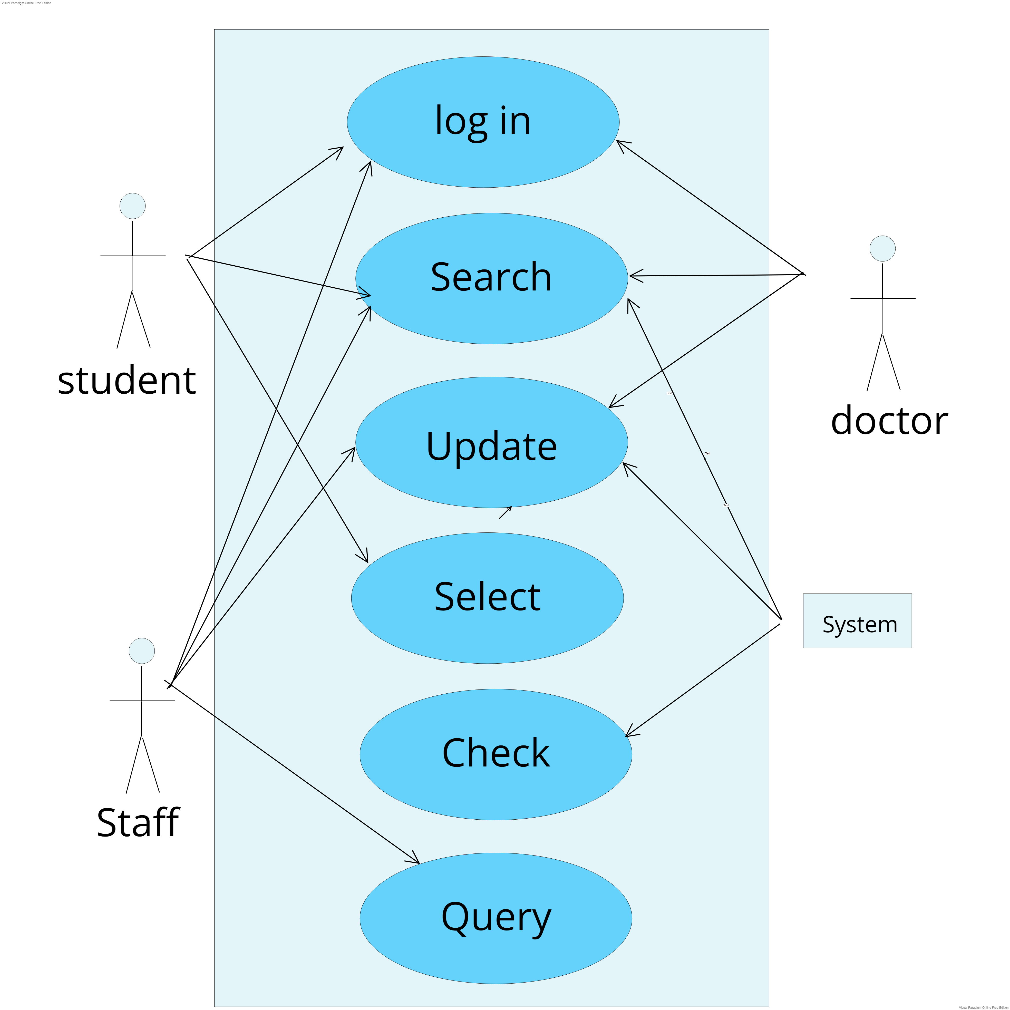
Balanced scorecard slide 3
Use case Diagram:

Slide 15
Balanced scorecard slide 3
Use cases:
Use case : Log in
ID: UC1
Priority : High
Actor: student, staff, doctors
Description : The student, staff and doctors
log in for the system to use it
Trigger : User selects the "log in ".
Type : External.
Pre-condition : User is not logged in.
Normal case:
1. User types a user name of his or her choice
2. User types a password
3. Submit.
4. System checks if the username is not already in use.
5. System checks if the password is not correct.
Post condition:
User logged in.
Alternative course:
4a. User name is already in use.
1. User is requested to select another user name and
password.

Slide 16
Balanced scorecard slide 3
Use cases:
Use case: Search.
ID: UC2.
Priority: high
Actor: System, staff, student and doctor
Description:
Staff: Searching for a specific student's data or specific data.
Student: searching about the table or his degree.
Doctor: according to Searching for
the data of a specific student his subject course.
System: doing the operation of the search.
Trigger: Searching about specific data.
Type: External.
Pre-condition: System shows all data.
Normal case: The system search about the required data
Post Condition: The system displays the required data.
Risks: Searching for wrong or missing data.

Slide 17
Balanced scorecard slide 3
Use cases:
Use case: Update
ID: UC3
Priority: High
Actor: Doctor, Staff, System
Description:
Doctor: Update or adds absence
Staff: Update or adds data
System: Update the schedule and the GPA
Trigger: Information of the system needed to be updated
Type: External.
Pre-condition: No updated information need to be update.
Normal case:
1. select a specific student
2. check if he is not updated already
3. Update specific data
4. Submit.
Post condition: Data becomes Updated.
Alternative course:
2a. if he is updated already
1. update another user data

Slide 18
Balanced scorecard slide 3
Use cases:
Use case: Select
ID: UC4
Priority: High
Actor: student
Description:
The student select the courses allowed for him
Trigger: The student is successful in the subjects
related to the new courses
Type: External
Pre-condition: The system displays
the courses allowed for it
Normal case: Student chooses
select the courses allowed for him
Post condition: The student is allowed to
study these courses and take their exams
Risks: The student has already selected 18 hours

Slide 19
Balanced scorecard slide 3
Use cases:
Use case: Query
ID: UC6
Priority: medium
Actor: Staff
Description: Staff He wants to inquire about
specific information about the student
Trigger: You have a question or order
Type: External.
Pre-condition: You have a question or
the director sent an order to the staff
Normal case:
1. wants to know or take an order
2. select data
3. make Query
4. get result
5. give result to director
Post condition: get result.
Alternative course:
5a. if Query doesn't help the director
1.try another Query

Slide 20
Balanced scorecard slide 10
Data Flow Digram

Slide 21
Levels of DFD
context
student
staff
Teaching Assistant
Students information
Staff information
Staff information
0
College Management System
Doctors information
Admins information
Doctors
Admins

Slide 22
Levels of DFD
Level 1
student
1
Student data
Enter his code
And password
System check this data
Correct data
login
1
Analysis
data
3
2
Calculate
GPA
Show
Data
5
student
System analysis entered data
System calculate GPA
Update student data
Display data
Check degree
GPA of student
Update
degree
4
Store new data
Doctor
Doc update degree
Course degree
2

Slide 23
Levels of DFD
Level 2
1.1
System compare data
Enter his user name and password
Student register in collage
1.2
Ensure that the data are typically
2.1
student
The student registers at the university
Student data
Username and code
1
Student data
Result of compare
Student data
Request about degree
3.2
Display data
4.2
Renew
data
4.1
3.3
Update degree of course
Updated data
Calculated data
Calculate GPA
New data
2
Course degree
Student GPA
Show data to student
Store data
Calculated data
1
Student data
Collect data
3.1
student
Doctor
Doctor tests students

Slide 24
Logical DFD
student
1
staff
2
tables
3
Student GPA
System display student table
Student enter his username and code
Student select appreciate courses
GPA
1
2
register
Select course
3
4
Show table
search GPA
System check code
System save the courses
Student look up GPA
5
Show result of searching
Result of GPA
student
Student get the result

Slide 25
Physical DFD
student
Affairs courses
3
tables
4
Student GPA
2
Student enter his username and code
Student select appreciate courses
courses
table
Student code
GPA
1
2
Student open the system and types his username and code
Select(course) based on his GPA and degree
3
4
Student look up table
Student search about his GPA
System open profile
Current courses
System display student table
If the tow codes are identical the system will open
code
Result of GPA
5
Print the result of the report
(searching)(manual)
student
Get report of searching
1
codes

Slide 26
Balanced scorecard slide 10
ERD

Slide 27
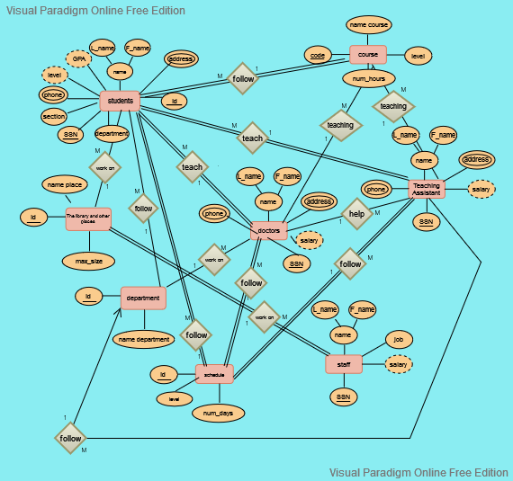
← ERD →

Slide 28
Balanced scorecard slide 10
Gathering data

Slide 29

Questionnaire about the college system
1 - كم مرة استخدمت سيستم الكلية: (4:1) , (5: 10) , (10: اكثر من ذلك)
2 - قم بتقييم سيستم الكلية :
3 - ما هو مقدار الإفادة (الخدمة ) التى يقدمها لك سيستم الكلية :
4 - ما رأيك فى أداء و سرعة سيستم الكلية :
سئ ) (جيد) ( جيد جدا) )
5 - ما رأيك فى مصدقية و دقة المعلومات والنتائج لدى سيستم الكلية :
ما هى الخدمة التى ترغب تواجدها فى سيستم الكلية ؟ - 6
------------------------------------------------------------------------------------
هل تواجه مشكلة فى استخدام السيستم ؟ - 7
------------------------------------------------------------------------------------
10
9
8
7
6
5
4
3
2
1
10
9
8
7
6
5
4
3
2
1
10
9
8
7
6
5
4
3
2
1

Slide 30
Balanced scorecard slide 10
Data dictionary

Slide 31
Data dictionary
Data Flow Description ID: DF1 Name: System Register Description: Contains student order information and used to allow student to login the system
Source Destination student Process
Type of data flow file Screen Report Form Internal
Data Structure Traveling with the flow Student information | Volume/time 2/h
Comment: Student record information for one student information student open the system and type his username and password
Data Flow Description ID : DF2 Name : System Register Description: Contains doctors/Assistant Teachers order information and used to allow doctors to login the system
Source Destination Doctors/Assistant Teacher Process1
Type of data flow file Screen Report Form Internal
Data Structure Traveling with the flow Doctors/Assistant Teachers information | Volume/time 2/h
Comment : Doctors record information for one doctors information .Doctors open the system and type his user name and password

Slide 32
Data dictionary
Data Flow Description ID : DF3 Name : Check code Description: Contains user code , used to sure that the two code are identical , if yes the system will open his profile
Source Destination Codes (data store) Process1
Type of data flow file Screen Report Form Internal
Data Structure Traveling with the flow User code | Volume/time 1/h
Comment: System ensures that the two code are identical, if yes the system will open his profile
Data Flow Description ID : DF4 Name : Selecting courses Description: contains the course where the student will choose the appreciate for him
Source Destination b Process1 Process2
Type of data flow file Screen Report Form Internal
Data Structure Traveling with the flow Courses information | Volume/time 2/h
Comment : Courses record information for one course information Student select the appreciate courses

Slide 33
Data dictionary
Data Flow Description ID : DF5 Name : Current Courses Description: Contains current courses of the student
Source Destination Process2 Process3
Type of data flow file Screen Report Form Internal
Data Structure Traveling with the flow Courses information | Volume/time 2/h
Comment : The courses is available
Data Flow Description ID : DF6 Name : student GPA Description: Contains GPA information of student
Source Destination Process3 Process4
Type of data flow file Screen Report Form Internal
Data Structure Traveling with the flow GPA information | Volume/time 2/h
Comment : GPA record information for one GPA information

Slide 34
Data dictionary
Data Flow Description ID : DF7 Name : Student Table Description: Contains Table information of student
Source Destination Tables(D5) Prosses4
Type of data flow file Screen Report Form Internal
Data Structure Traveling with the flow Table information | Volume/time 2/h
Comment : Tables record information for one table information
Data Flow Description ID : DF8 Name : Displaying the result Description: Contains the result information of searching
Source Destination Process4 student
Type of data flow file Screen Report Form Internal
Data Structure Traveling with the flow GPA and Table information | Volume/time 2/h
Comment : Display all information that the student want and display it as report

Slide 35
Data dictionary
Data Flow Description ID : DF9 Name : Updating degree Description: Contains new degree of student
Source Destination Doctors/Assistant Teachers Process6
Type of data flow file Screen Report Form Internal
Data Structure Traveling with the flow Degree of student information | Volume/time 2/h
Comment : Degree information that will stored in data store of degree
Data Flow Description ID : DF10 Name : Storing GPA Description: Contains degree information of students
Source Destination Process6 Process7
Type of data flow Screen Report Form Internal
Data Structure Traveling with the flow Degree information | Volume/time 2/h
Comment : Storing information in data store of degree to make it available to use
file

Slide 36
Data dictionary
Data Flow Description ID: DF11 Name: Combine degree Description: contains degree record of student that will be combined
Source Destination Affaris Prosses7
Type of data flow file Screen Report Form Internal
Data Structure Traveling with the flow Degree information | Volume/time 2/h
Comment : Combine degree of student to calculate GPA
Data Flow Description ID : DF12 Name : System Register Description: Degree information about student
Source Destination Degree (data store) Prosses7
Type of data flow file Screen Report Form Internal
Data Structure Traveling with the flow Doctors/Assistant Teacher information | Volume/time 2/h
Comment: Doctors record information for one doctor information Doctor open the system and type his username and password
file

Slide 37
Data dictionary
Data Flow Description ID: DF13 Name: System Register Description: Contains doctor or assistant teacher order information and used to allow them to login the system
Source Destination Doctor/Assistant Teacher Prosses1
Type of data flow file Screen Report Form Internal
Data Structure Traveling with the flow Degree of information | Volume/time 2/h
Comment : The information of degree that will be combine
Data Flow Description ID : DF14 Name: Calculating GPA Description: Contains degree information, used to calculate GPA
Source Destination Process7 Process8
Type of data flow file Screen Report internal form
Data Structure Traveling with the flow Volume/time Degree information 2/h
Comment : Degree will be calculate to get GPA

Slide 38
Data dictionary
Data Flow Description ID : DF15 Name : Saving GPA Description: Contains GPA information , used to move GPA information to GPA data store
Source Destination Process8 Student GPA (Data store)
Type of data flow File Screen Report Form Internal
Data Structure Traveling with the flow Student GPA information | Volume/time 2/h
Comment : The GPA of student store in data store to be available when we use it
Data Flow Description ID : DF16 Name : GPA Description: Contains GPA information
Source Destination Student GPA (data store) Process3
Type of data flow file Screen Report Form Internal
Data Structure Traveling with the flow Student GPA information | Volume/time 2/h
Comment : The Student GPA is available to use

Slide 39
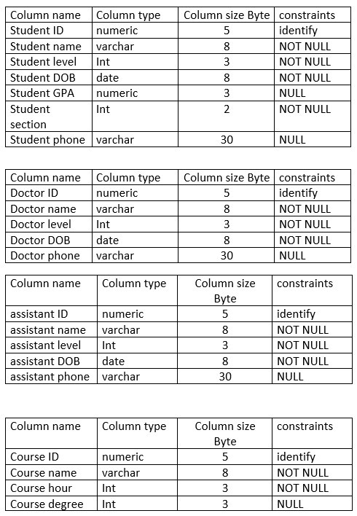
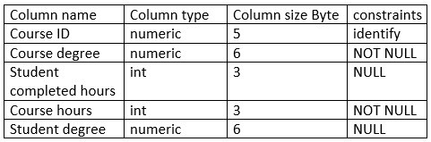
Data dictionary

Slide 40
Data dictionary
Name | Student tables
Alias | Section tables
Description | Contains of section tables
Length | 200
Input format | X[200]
Output format | X[200]
Continuous/Discrete | Continuous
Type | Alphabetic
Base / Derived | Derived
Name | Student id
Alias | Section id
Description | Contains of section id
Length | 20
Input format | X[20]
Output format | X[20]
Continuous/Discrete | continuous
Type | number
Base / Derived | Base

Slide 41
Element description
Name | Student name / doctor name / Assistant Teachers
Alias | Section name
Description | Contains of section name
Length | 200
Input format | X[200]
Output format | X[200]
Continuous/Discrete | Discrete
Type | Alphabetic
Base / Derived | Base
Name | Student telephone
Alias | Section telephone
Description | Contains of section numbers
Length | 20
Input format | X[20]
Output format | X[20]
Continuous/Discrete | Continuous
Type | numbers
Base / Derived | Derived
Name | Student address / Doctor address
Alias | Section id
Description | Contains of section address
Length | 200
Input format | X[200]
Output format | X[200]
Continuous/Discrete | Discrete
Type | Alphabetic
Base / Derived | Base
Name | Student GPA
Alias | Section GPA
Description | Contains of section GPA
Length | 20
Input format | X[20]
Output format | X[20]
Continuous/Discrete | continuous
Type | number
Base / Derived | Derived

Slide 42
Balanced scorecard slide 10
THANK YOU

